Slide 1
8.0. Business Communication
Executive Diploma in Business Management

Slide 2
8.0. Introduction to Communication
The Definition of Communication
A gentleman orders a coffee in a crowded cafe. The young woman in line behind him shoots a withering look at the rambunctious toddler tugging on her coat. From the radio blares an advertisement for a one-day sale at the mall. At a nearby table, a deaf couple signs to each other, while a teenager in the corner busily texts a friend on his cell phone. These situations all have one thing in common. They all involve communication.

Slide 3

8.1. Definition
The Definition of Communication
Communication is the act of conveying information for the purpose of creating a shared understanding.
It’s something that humans do every day. The word “communication” comes from the Latin “communist,” meaning “to share,” and includes verbal, non-verbal and electronic means of human interaction.
Scholars who study communication analyze the development of communication skills in humans and theories about how communication can be made more effective
Humans convey information through a variety of methods: speaking, telephones, email, blogs, TV, art, hand gestures, facial expressions, body language and even social contexts.
Communication can occur instantaneously in closed, intimate settings or over great periods of time in large public forums, like the Internet. However, all forms of communication require the same basic elements: a speaker or sender of information, a message, and an audience or recipient.

Slide 4
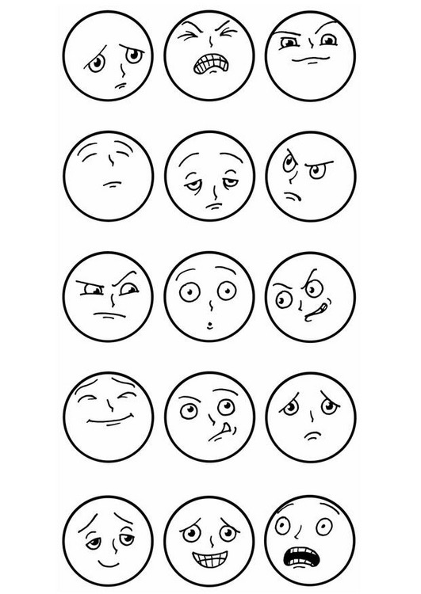
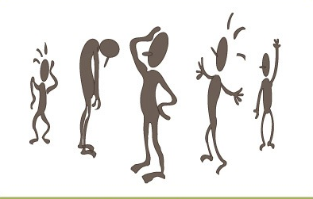

Hand gestures, Facial expressions, Body language

Slide 5
8.2. What is communication?
Humans convey information through a variety of The sender and recipient must also share a common language or means of understanding each other for communication to be successful. As such, a study of communication often examines the development and structure of language, including the mathematical languages used in computer programming.
The act of communicating draws on several interpersonal and intrapersonal skills. These include speaking, listening, observing, questioning, processing, analyzing and evaluating. Recipients of a message must be able to identify the sender’s intent, take into account the message’s context, resolve any misunderstandings, accurately decode the information and decide how to act on it. Such skills are essential to learning, forming healthy relationships, creating a sense of community and achieving success in the workplace.

Slide 6
What is communication?
As a field of study, communication spans a broad, rich array of subjects, including sociology, psychology, philosophy, political science, linguistics, history, literature, criticism and rhetoric. Although much of the field’s subject matter is theoretical in nature, communication studies have proven applicable to business, film, theatre, composition, advertising, education, foreign policy and computer science.
In today’s globalised, media-driven world, communication studies have become more relevant and exciting than ever. Web developers seek new, inventive ways to draw Internet users to their websites. Public policy writers debate society’s most pressing issues. Through linguistics, computer scientists are developing programming languages that may someday allow humans to interact directly with computers

Slide 7
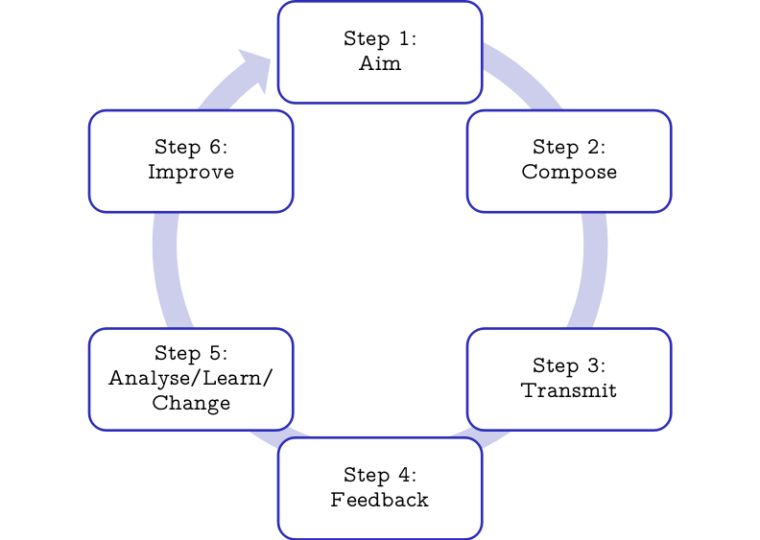
8.3. Communication Cycle
The Communication Cycle is THE Secret of Effective Leadership
If you want to be a highly effective leader one of the most important secrets you need to master is the thorough use of The Communication Cycle. In this lens I will take you through the six steps of the cycle in detail. By mastering the 6 steps your rating as a leader will improve dramatically in any situation; in any organization whether it be government, business or education.

Slide 8
Communication Cycle
Step 1: Aim - Who do you want to talk to and what do you want them to do?
Step 2: Compose - What is the best way to talk to your audience in order to get them to do what you want?
Step 3: Transmit - Where and when should you communicate in order to optimize your results?
Step 4: Feedback - Find out exactly what effect your communication created.
Step 5: Analyze/Learn/Change - Analyze and learn from the results your communication created.
Step 6: Improve - Change your behavior as a result of what you have learned

Slide 9
8.4. The communication process
Sender – the person who wants to communicate certain information to another party
Encoding – selecting appropriate symbols includes words, numbers, other verbal and non-verbal cues
Message – is encoded by the sender into symbols and gestures that the receiver can understand
Medium – is the mode of transmission; this could be written or oral, such as reports or interviews
Receiver – the receiver has to decode the message and translate it into information that is meaningful to him
Decoding – translating and attempting to understand the message
Noise – any factor that disturbs, confuses or interferes with communication
Feedback – the sender needs to receive feedback to ensure that the message has been received and understood

Slide 10
8.5. Types of communication
Verbal communication
Face-to-face
Telephone
Radio or Television
Other media
Non-Verbal communication
Body language
Gestures
How we dress or act
Even our scent

Slide 11
Types of communication
Written communication
Letters
Emails
Books
Magazines
The Internet
Other media
Visual communication
Graphs
Charts
Maps
Logos
Other visualizations

Slide 12
8.6. Types of communication
Verbal Communication
This includes all forms of oral communication, usually face-to-face, or via the telephone
Non-Verbal communication
This is also referred to as “body language and includes all gestures and expressions
Written communication
This includes all written forms of communication such as letters, reports, memos, diagrams, charts and graphs
Personalised or standardised
Stored and can be revised when needed

Slide 13
Types of communication
Visual communication
Visual communication is communication through visual aid and is described as the conveyance of ideas and information in forms that can be read or looked upon
Visual communication in part or whole relies on vision, and is primarily presented or expressed with two dimensional images, it includes: signs, typography, drawing, graphic design, illustration, colour and electronic resources. It also explores the idea that a visual message accompanying text has a greater power to inform, educate, or persuade a person or audience

Slide 14
8.7. Organizational Communication
Vertical Communication Flow
This includes both downward and upward communication
Managers pass instructions and orders to subordinates (downward) and receive feedback on tasks, complaints, and grievances from the employees (upward)
Lateral Communication Flow
This type of communication takes place when employees at the same level in a company interact with each other and share information and ideas
Informal Communication Flow
This is the type of communication that does not follow the official channels of communication
It is also commonly referred to as “the grapevine”

Slide 15
8.8. Effective communication
Steps to effective communication
Communication plan
Impact assessment
Monitoring communication activities
Proper evaluation

Slide 16
8.9. Feedback
Definition:
Information about reactions to a product, a person's performance of a task, etc., used as a basis for improvement
The modification or control of a process or system by its results or effects, e.g. behavioral response

Slide 17
Feedback
Acquiring feedback
Employee surveys
Memos
Emails
Open-door policies
Company news letter

Slide 18
8.9.1. Feedback cycle
When two people interact, communication is rarely one-way only.
When a person receives a message, he/she responds to it by giving a reply.
The feedback cycle is the same as the sender-receiver feedback

Slide 19
8. 10. Levels of communication
INTRAPERSONAL COMMUNICATION
Intrapersonal communication is the active internal
involvement of the individual in symbolic processing of
messages. The individual becomes his or her own sender
and receiver, providing feedback to him or herself in an
ongoing internal process. It can be useful to envision
intrapersonal communication occurring in the mind of the
individual in a model which contains a sender, receiver,
and feedback loop.

Slide 20
Levels of communication
INTERPERSONAL COMMUNICATION
Interpersonal communication is defined by communication
scholars in numerous ways, though most definitions
involve participants who are interdependent on one
another, have a shared history. Communication channels
are the medium chosen to convey the message from sender
to receiver. Communication channels can be categorized
into two main categories: Direct and Indirect channels of
communication.

Slide 21
Levels of communication
GROUP COMMUNICATION
Refers to the nature of communication that occurs in
groups that are between 3 and 12 individuals. Small group
communication generally takes place in a context that
mixes interpersonal communication interactions with
social clustering.

Slide 22
Levels of communication
PUBLIC COMMUNICATION
It‘s at the heart of our economy, society, and politics.
Studios use it to promote their films. Politicians use it to
get elected. Businesses use it to burnish their image.
Advocates use it to promote social causes. It's a
field built on ideas and images, persuasion and
information, strategy and tactics. No policy or product can
succeed without a smart message targeted to the right
audience in creative and innovative ways

Slide 23
8.11. Balance of interpersonal communication
The Johari window model focuses on the balance of interpersonal communication. Interpersonal communication encompasses:
Speech communication
Nonverbal communication
Summarizing
Paraphrasing
listening
questioning

Slide 24
Balance of interpersonal communication
Having good interpersonal communication skills support such processes as:
Parenting
Management
Selling
Counseling
Coaching
mentoring and co-mentoring, 指导与被指导 which is mentoring in groups
conflict management

Slide 25
8.12. Communication Skill
Every individual needs to be well equipped with 装备着 the tools to communicate effectively, whether it is on the personal front, or at work. In fact, according to the management experts, being a good communicator is half the battle won 有助于成功的条件
After all, if one speaks and listens well, then there is little or no scope for misunderstanding. Thus, keeping this fact in mind, the primary reasons for misunderstanding is due to inability to speak well or listen effectively
Communication skills include lip reading, finger-spelling, sign language 手语; for interpersonal skills use, interpersonal relations
Skills is the set of skills that enables a person to convey information so that it is received and understood. Communication skills refer to the repertoire 全部技能 of behaviours that serve to convey information for the individual
Communication skills is the ability an individual displays in consistently 一致地 demonstrates 论证 the ability to effectively communicate with clients, colleagues,subordinate, and supervisors in professional manner and in the personal department
Communication skills is the ability to use language (receptive) and express 传递 (expressive) information

Slide 26
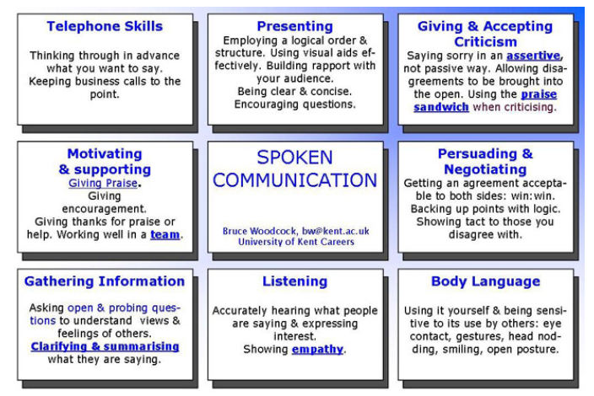
Types of communication skill

Slide 27
8.12.1. Spoken communication
Effective spoken communication requires being able to express your ideas and views clearly, confidently and concisely in speech, tailoring your content and style to the audience and promoting free-flowing communication.
Be clear and concise: Vary your tone, pace and volume to enhance the communication and encourage questions
Persuading and Negotiating : Arriving at an agreement that is agreeable to both sides: a win:win situation. Back up your points with logic. Show tact to those you disagree with
Making a speech in front of an audience: Presenting your message in an interesting way, structuring your presentation, using audio-visual aids effectively and building a rapport with your audience
Communicating effectively in a team
Ask for help when you need it. Research suggests that asking for help with something (within reason) makes you more liked by the person you ask!

Slide 28
8.12.2. Listening
Make effective us of body language and speech: Be sensitive to the other person’s body language as well as what they say: eye contact, gestures, appropriate humour and analogies. Use appropriate body language yourself: face the person with an open, attentive posture and maintain good eye contact ( look at the speaker a lot, but don’t stare all the time ), smiling and nod your head from time to time
Listen attentively . Express interest in what people are saying and don’t interrupt them
Good listening builds a rapport and understanding with the speaker and allows them to freely express their views. It motivates them to say more
Poor listening makes assumptions, creates resistance and hostility, demotivates the speaker, inhibits their development and creates dependence on the listener

Slide 29
8.12.3. Active Listening
These reflect back what the speaker is saying in other words to clarify understanding: you paraphrase and repeat back key points
They may summarise and bring new interpretation to the speakers words
They encourage the speaker to elaborate and to define their problems
It is often the most useful way of giving positive feedback to someone: “I hear what you’re saying and take it seriously”.You can’t keep saying”uh-huh” or “yes” for too long without it sounding false

Slide 30
8.12.4. Empathy
e.g People with a musical quality to their speech (a big variation in pitch and rhythm called prosody) tend to be more empathic. Lisa Aziz-Zadeh of the University of S. California found that people whose speech is most intonated, lilted or "sing-song" have more ability to empathise with others and to convey emotion. Empathy means being open to the ideas of others and sensitive to their values and feelings: trying to see things from the other person's perspective
Each individual has a unique perspective which should be valued. We each occupy our own private world and never completely know what’s going on inside other people’s minds
Be prepared to disclose your own feelings and beliefs to encourage others to do the same: be open with other people

Slide 31
8.12.5. Confirm and clarify
Ask yourself exactly what you want to gain from the conversation: a lack of clarity can lead to confusion and poor decisions
Asking clarifying questions: "How?", "Why?", "When?", "Who?", "What?", "Where?", will help the other person crystallize their thoughts
Summarize the main points in simple language
Get the other person's agreement that your summary is accurate
Define the problem and then move the focus to the solution: separate the points that relate to the problem and those that relate to the solution
Agree on the action you will both take: even if this is that there will be no action

Slide 32
8.13. Workplace communication
Workplace communication is the process of exchanging information, both verbal and non-verbal, within an organisation. An organisation may consist of employees from different parts of the society. In order to unite the activities of all employees, communication is crucial
Communicating necessary information to the entire workforce becomes necessary. Effective workplace communication ensures that all the organisational objectives are achieved .(the importance of workplace communication)

Slide 33
8.13.1. Factors influencing workplace communication
Method of communication:
Different people absorb information in different ways. To make sure that the information conveyed is understood by all, the method used for communication needs to be simple and clear. When presenting vital information, using pictures will make way for easy understanding. Preferring two-ways communication is considered best for communicating. Adequate importance can be given for discussion, questions and clarifications^{[1}
Content:
The content of the information plays a major role in workplace communication. The level of detail must be according to the capacity of the audience.
e.g Giving too much detail may get the audience bored and too little detail won’t make them involved. Use of jargon while communicating is not considered good for effective workplace communication

Slide 34
8.13.2. Factors influencing workplace communication
Frequency:
While formal workplace communication that is done too rarely很少 or too often is not good for an organization, frequent informal workplace communication has its benefits. A perfect balance is required for the proper functioning of an organization. Information must be communicated as and when required rather than holding unnecessary meetings frequently. At the same time crucial information must not be held till the last hour or day, instead they have to be communicated as early as possible to get the employees in tune with the objectives of the organization
Skills:
Getting the message across efficiently depends on the skills of the communicator such as presentation skills, group facilitation skills and written communication skills. Successful communication also depends upon the capacity of the employees to understand the information. This requires providing the employees some basic financial literacy like financial statements, sales, profitability, etc that’s so call support information

Slide 35
8.14. Important for a business to achieve effective communication
Motivates employees – helps them feel part of business
Easier to control and coordinate business activity – prevents different parts of business going in opposite directions
Makes successful decision making easier – decisions are based on more complete and accurate information
Better communication with customers will increase sales
Improve relationships with suppliers
Improves chances of obtaining finance – e.g. keeping bank up-to-date about how business is doing
The link between communication and motivation is particularly important. Good communication is an important part of motivating employees and the main motivational theorists recognized this:
Mayo emphasized importance of communication in meeting employees’ social needs
Maslow and Herzberg stressed importance of recognizing employee’s achievements and self-esteem needs

Slide 36
8.14.1. Communicating effectively: The Manager
A manager may be at risk if he/she
Always seems to be feuding with someone or some group in the organization
Has a reputation for being authoritarian, cold, aloof, arrogant, or insensitive
Acts as a polarising force within an organization
Avoids direct communication or contact with some or all co-workers
Delivers bad news through e-mail rather than through direct conversations
Exhibits a hostile attitude towards co-workers who share interdependent goals

Slide 37
Communicating effectively: The Manager
Consider the Situation Before taking Any Action
Our emotions tempt us to make quick decisions based upon superficial evidence which may not reflect the true nature of the problem.
For example: The manager assumed that the poor appearance of the store was due to the employees’ lack of effort or attention. He failed to consider that several store employees had been terminated due to the financial situation, while the store’s workload remained the same. Each assistant manager was responsible for more areas with fewer people to do the work. Furthermore, each assistant had been required to take a pay reduction due to the loss of the large customer, and each was concerned that the customer loss would slow their own promotion to store manager. Though not intended, their effort probably suffered due to their own worries

Slide 38
Communicating effectively: The Manager
Gather and Confirm Information Before Making a Decision
We have a tendency to confuse symptoms with disease, and consequently treat the symptom rather than the underlying illness. Technology enables us to capture massive amounts of data and slice and dice it to make it appear any way we want. But data is a representation of the problem, not the problem itself. Observing the work of the assistants and talking and listening to them about the aspects of their job might have led to a different conclusion than the one the manager reached.
Focus on Problems, Not Personalities
The manager’s memo attacked the character of each assistant by implying they were lazy, derelict, or had betrayed him. The implications intensified the emotional context of the memo, overshadowing its factual content and purpose.
The assistants, in response, reacted with emotion without stopping to consider the validity of the facts or attempting to give the manager any explanations. Whenever dealing with any issue that might have emotional content, the “24-Hour Rule” should be in effect: Don’t send any email, message, letter, memo, or report to others until you’ve had a day to reflect upon its content and are sure it communicates the facts and the tone you wish.

Slide 39
Communicating effectively: The Manager
Manage Individuals, Not Groups
The manager’s memo was directed to everyone and no one. The lack of specificity enabled each recipient to avoid personal responsibility, since each felt his own effort had met expectations. As a consequence, the memo failed to get the desired result and aggravated an already touchy work environment. Group communications are perfect for providing general information, education, and praise; however, they should not be used for individual direction or criticism. Remember, praise in public and criticize in private.
Meet Subordinates Face-to-Face
The meaning and intent of written words without the context of a physical presence is often misunderstood, and can lead to confusion and conflict. There is no substitute for looking someone in the eye and seeing their reaction to your conversation to clarify content and assure comprehension and agreement.
Managers often hide behind memos and notes as if their subordinates were robots to be moved into place and programmed. However, successful leaders seek personable commitment and build bridges of trust, mutual respect, and shared experience. Be physically available and “walk the walk,” and let your people know you are with them through the good and the bad

Slide 40
Communicating effectively: The Manager
Assign Tasks Directly and Clearly
People work best when they know what is expected of them. Good managers identify the goals and measures in simple, understandable terms, assign responsibility unequivocally, and confirm that the information is understood by those to whom it is directed. Good managers follow up and give corrective input to ensure that each of his subordinates is on the same page and working toward the same objective
Managers should always remember that no employee takes a job with the expectation that he or she will be overlooked, ignored, or insignificant at work. Employees want to be liked and respected by their peers and proud of their employer. Management’s challenge is to maintain and further develop this employee enthusiasm and commitment, even during times of stress. Mistakes are part of growing, and falling short and correcting the course are regular occurrences in business and in life. Dealing with subordinates the way you would wish to be dealt with in a similar situation is the best course any manager can take.

Slide 41

8.15. Remedy Poor Communication Skills
To remedy an “at risk” manager, try to understand the true root cause of conflict. Does your manager have a personal or political problem with just one or two people, or does your manager have more significant issues with a number of different people? If the conflict stems from a small personal issue then mediatea resolution immediately rather than letting it fester. If it is a more serious issue, consider relocating or removing that manager.
Understand the manager’s management style and motivation. Some people just aren’t cut out to be managers, although they may be exceptional individual contributors. Other people just don’t want to be managers. And while some people may have what it takes to lead, they might not have the skills or experience to do the job. If your manager’s issue is the latter, it may be easier to help him develop his skills than it is to train someone who completely lacks the behaviours and interests that lead to success
Help the manager understand his own management and communication style. In many situations managers simply don’t know what they don’t know.
For example, if he comes across as insensitive or aloof, point out the behaviour and help him improve. It is important for the manager to understand his natural management style and how it impacts others both positively and negatively. The manager can’t be expected to improve if he never receives concrete feedback.

